Slide 1

www.espirity.com
Java IDE
Dwight Deugo (dwight@espirity.com)
Nesa Matic (nesa@espirity.com)
Notes:
Portions of the notes for this lecture include excerpts from the Eclipse 3.0 and 3.1 Help facility. These excerpts are made available under EPL for ease of use by instructors, (c) Copyright (c) 2000, 2005 IBM Corporation and others. For more complete information instructors are encouraged to read the full notes from the Eclipse Help facility.

Slide 2
Additional Contributors
None as of September, 2005

Slide 3
Module Overview
Building and Running Java Classes
Notes:
In this section, we discuss how to use Eclipse to build a Java application.

Slide 4
Module Road Map
Building and Running Java Classes
  Developing Java applications
    Projects, packages, classes
  Browsing Java code
  Searching Java code
  Organizing Java code
  Using Code Assist
  Running Java applications
  Scrapbook
Notes:
Let’s begin by using Eclipse to build your Java project. We will be discussing Eclipse’s Java and Java Browsing perspectives, as well as how to build and run Java applications with Eclipse.

Slide 5
Java Development Tooling - JDT
Eclipse’s Java Development Environment is often referred to as JDT – Java Development Tooling
  Using the JDT you can do following with the Java programs:
    Write
    Compile
    Test
    Debug
Notes:
Java Development Tooling is the set of Eclipse plug-ins that allow you to write Java programs. It is fully featured Integrated Development Environment.

Slide 6
Perspectives
When developing Java code commonly used perspectives are:
  Java Perspective
    Designed for working with Java projects
  Java Browsing Perspective
    Designed for browsing structure of Java projects
  Java Type Hierarchy Perspective
    Designed for exploring type hierarchy
  Debug Perspective
    Designed for debugging Java programs
Notes:
In this module we will talk about Java Perspective, Java Browsing Perspective and Java Type Hierarchy Perspective.

Slide 7
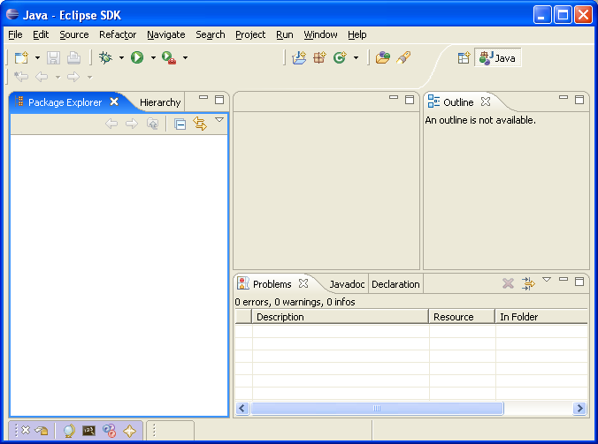
Java Perspective
Contains:
  Editor area
  Package Explorer View
  Hierarchy View
  Outline View
  Problems View
Notes:
The Java Perspective is where you spend most of your time when developing Java code.
Package Explorer View shows the Java element hierarchy of the Java projects in the Workbench.
Hierarchy View shows the hierarchy of a type.
Outline View displays an outline of a structured file that is currently open in the editor area, and lists structural elements. For example an outline view for a Java class displays all fields and methods for that class. The contents of the outline view are editor-specific.

Slide 8
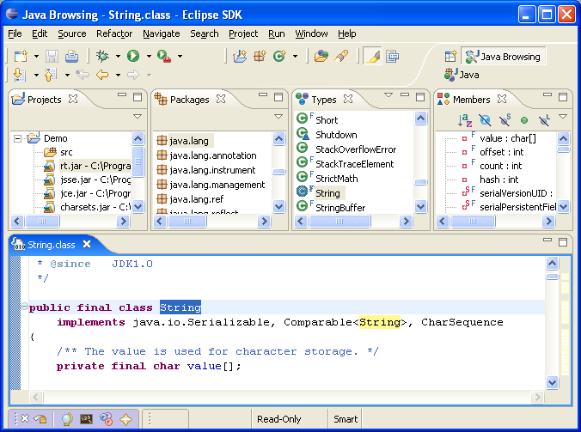
Java Browsing Perspective
Contains:
  Editor area
  Projects View
  Packages View
  Types View
  Members View
Notes:
Projects View shows all projects available in the Workbench.
Packages View shows all packages available for project selected in the Projects View.
Types View shows all Types (classes and interfaces) from the package selected in the Package View.
Members View shows all fields and methods for the type selected in the Types View.

Slide 9
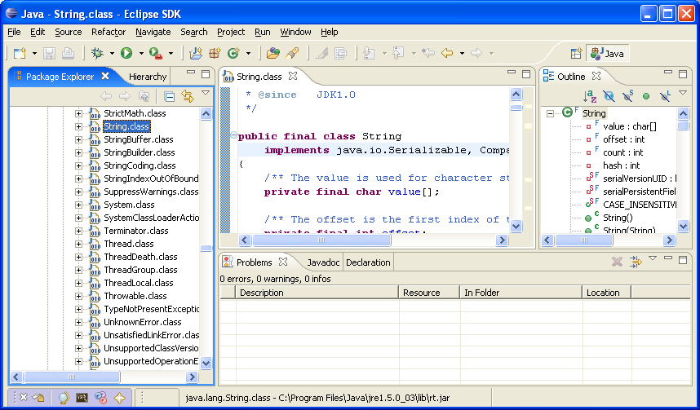
Java Type Hierarchy Perspective
Contains editor area and Hierarchy View
Notes:
The Java Type Hierarchy Perspective is not used as much as the other two Java perspective.

Slide 10
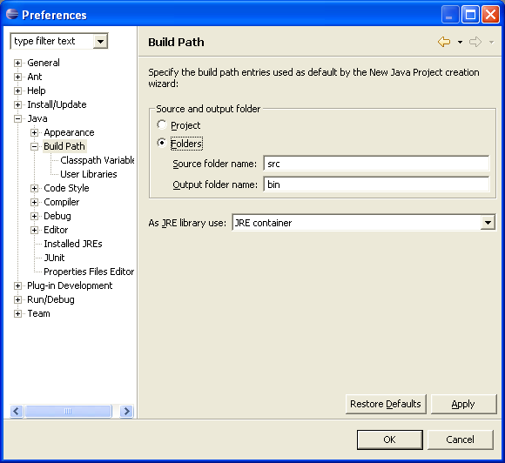
Build Path Project Preferences
You can set global preferences for a project
Select Window -> Preferences -> General -> Java to get Java Preferences
Good idea to separate your Java files into source and compiled directories (src and bin)
This action only needs to be done once
Done for all subsequent projects

Slide 11
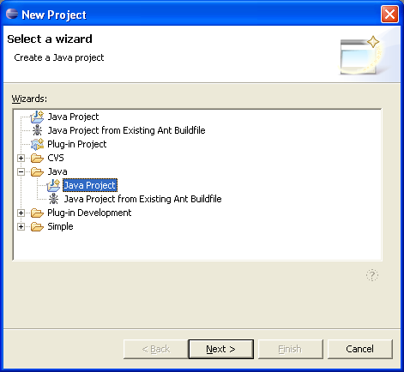
Creating Java Project
Project used to organize resources (source, class, icons) for a project
To create Java project:
  Select File → New → Project… from the menu
  The New Project wizard comes up
  Select Java → Java Project
  Click Next

Slide 12
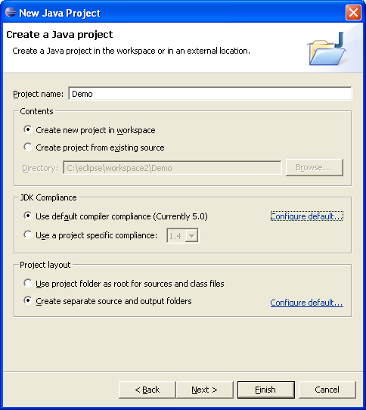
New Project Wizard
Specify Project Name
Click Next

Slide 13
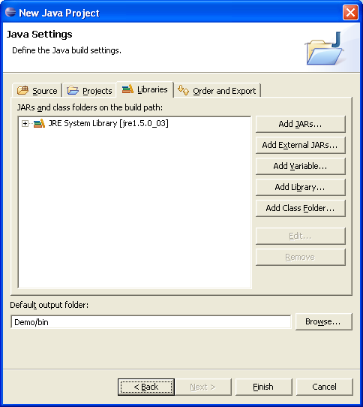
Java Settings
Specify Java settings
  Output folder (where compiled files will be stored)
  External jar files project depends on
  Classes from other projects that are referenced in the project
Click Finish
Notes:
The Java Settings for a project is very important as you use it to set Java build path. You don’t have to set the build path at the project creation time, as at any given time you can go back to the build path through Properties for the project.

Slide 14
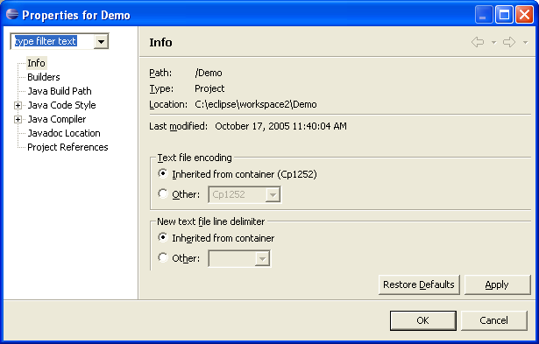
Project Properties
You can change the Java build path at any time
  Choose Properties from the context menu while selecting the project

Slide 15
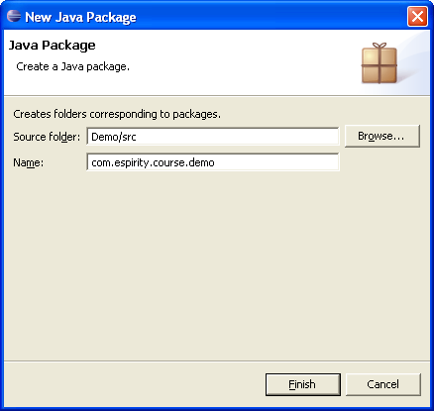
Creating Packages
Package contains Java class files
To create a package for a project:
  Select the src folder in the project
  Choose New → Package from the context menu
  Specify package name
  Click Finish

Slide 16
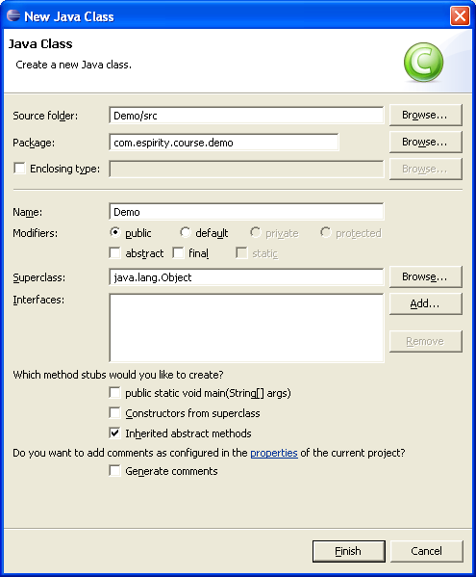
Creating Classes
To create a class in a package:
  Select the package
  Choose New → Class from the context menu
  The Class wizard comes up
  Specify class details
  Click Finish
Notes:
If you specify wrong details for the class in the wizard, you can always change them later directly in the editor. When creating class Eclipse gives you an option of specifying if you would like to create a main() method for the class, or create constructors from the superclass. In the wizard you specify superclass for the class as well as modifiers (abstract, final, etc.)

Slide 17
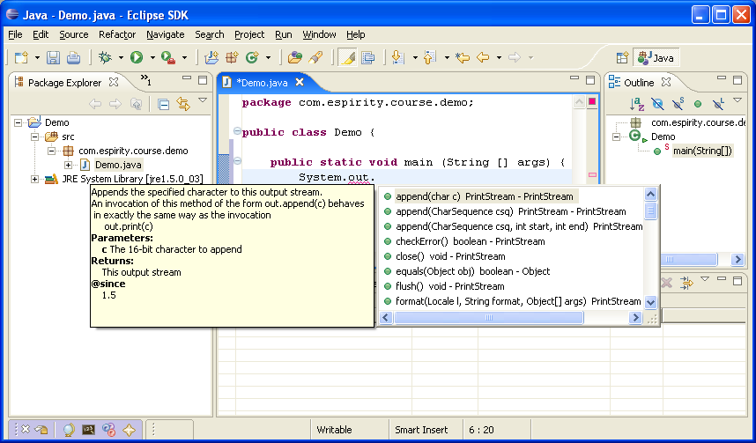
Using Code Assist
When activated, code assist opens a list of available code completions
Code Assist activates by Crtl+Space
  Activates automatically when a message needs to be sent to an object (after the dot is typed)
Notes:
Code Assist can also be activated from the Edit menu by choosing Edit -> Content Assist. It could be customized in the Preferences window.

Slide 18
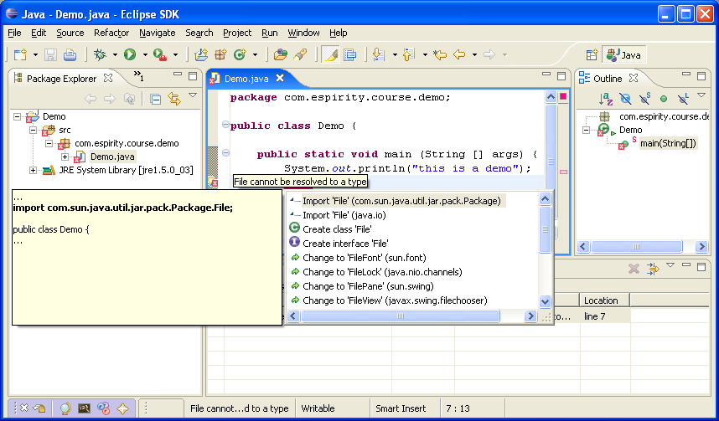
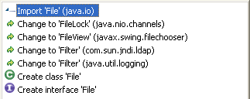
Using Quick Fix
Useful if Java compiler shows errors
  Gives options for fixing the errors
  Activated through Edit → Quick Fix menu option
Error indication
Notes:
Quick Fix can be used for fixing the compiling errors. In the above example type File is used for declaring field file. The error is indicated by a red rectangle on the right of the line, by red underlined name of the missing type, and by error icon on the left from the line.
Quick Fix can also be activated by click on the bulb icon in the editor.

Slide 19
Searching for Java Classes
When developing Java application a good search mechanism is very important
  You often search for class, method declarations, and references
  It is important to be able to find things quickly
Eclipse Java Search mechanism is very extensive
It allows you to search for:
  Types, methods, constructors, packages, and fields
  Declarations, Implementers, References
  In the scope of Workspace, Working Set, or Selected Resources

Slide 20
Organizing Java Code
Eclipse comes with extensive support for organizing and refactoring Java code
It is possible to:
  Generate getters and setters for the fields
  Organize missing import statements
  Move fields, methods, classes
  Rename methods, classes, packages

Slide 21
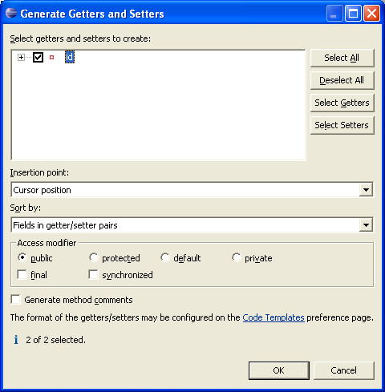
Generating Getters and Setters
Available for creating get and set methods on the fields
  It supports encapsulation
  Activated by choosing Source → Generate Getter and Setter from the editor’s context menu
Notes:
Generation of getters and setters for instance variables support one of the first object-oriented principals: encapsulation. Encapsulation is that no internal state of an object should be accessed directly. This means that an internal object state should be represented through private field, and a method for accessing field should be provided. Object’s internal state is than accessed by sending a message that represents that method to object. Method for accessing object’s internal state is known as getter (get method) and method for setting object’s internal state is known as setter (set method). Usually each private field has corresponding getter/setter methods.

Slide 22
Refactoring
Available from the Refactor context menu option in the editor
Helps with refactoring Java code
Allows for:
  Renaming
    Methods, fields, packages, projects, parameters, or local variables
  Changing of method signature
  Pull up a field or method (into super class)
  Push down a field or method (into sub class)
  Extract Interface (generate interface from class)
  Generalize type (change type of fields and methods)
Notes:
Refactoring is commonly used in programming and its goal is to improve the code by not affecting its functionality.
You can preview all of the changes resulting from a refactoring action before you choose to actually do the changes.
During the preview you will be notified of potential problems and will be presented with a list of the changes the refactoring action will perform.

Slide 23
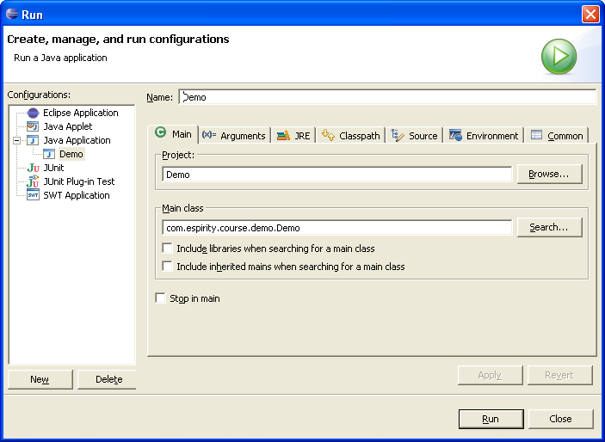
Running Java Classes
To Run Java application
  Choose Run → Run… from the menu
Notes:
When you open Run Dialog under Java Application are listed all classes that contain main() method, i.e. that can be run. If your class is not listed here, click on New to add all classes with main() method to this list.
In the Run Dialog you can set some options before starting the Java application. You can set program and VM arguments on the Arguments page. You can also set Java Runtime Environment on the JRE page, and you can change the classpath on the Classpath page.

Slide 24
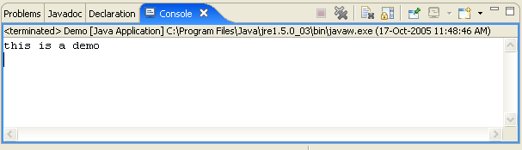
Console View
Represents standard Java console
Opens by default when standard Java output is used
  Can also be open from Window → Show View menu
System.out.println("this is a demo");

Slide 25
Scrapbook…
Allows for writing and executing of Java code
  Very useful for quick test of Java code that you write
The Java code in the Scrapbook can be:
  Displayed as a string when evaluated
  Inspected when evaluated
    Opens an Inspector view where you can see returning object from evaluation and all containing fields
  Executed

Slide 26
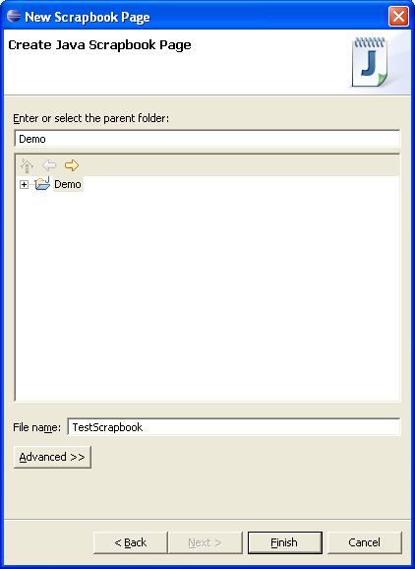
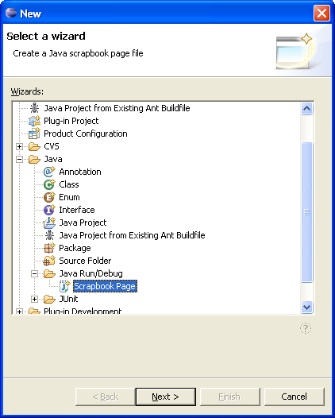
…Scrapbook…
It is created by selecting a project and choosing New → Other… → Java → Java Run/Debug → Scrapbook Page from the Package Explorer’s context menu and then entering the name of the page
Your scrapbook page will become a resource in your project

Slide 27
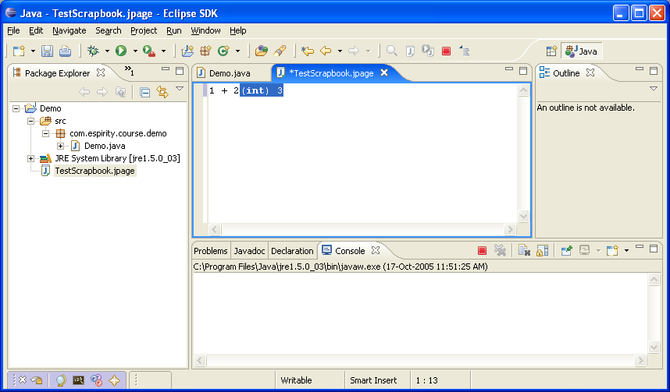
… Scrapbook…
To open the scrapbook page just click on the resource
It opens up like a Java source file editor
Type Java code and select the context menu to Display or Inspect

Slide 28
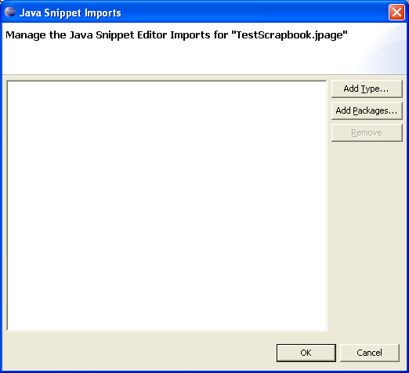
…Scrapbook
Class names must be fully qualified in what you type
Set imports to make life easier
Think of your scrapbook as a page that Eclipse will take the source you type, wrap it in a class with your source in the main menu, then compile and execute

Slide 29
Summary
You have learned:
  How to create projects, packages and classes
  How to browse Java code and search for Java code
  How to use coding assistance
  How to organize Java code
  How to run Java code
  How to use the Scrapbook

Slide 30

Labs!
Lab: Building and Running a Java Application
Notes:
Now it’s time for the lab.

